Slide 1
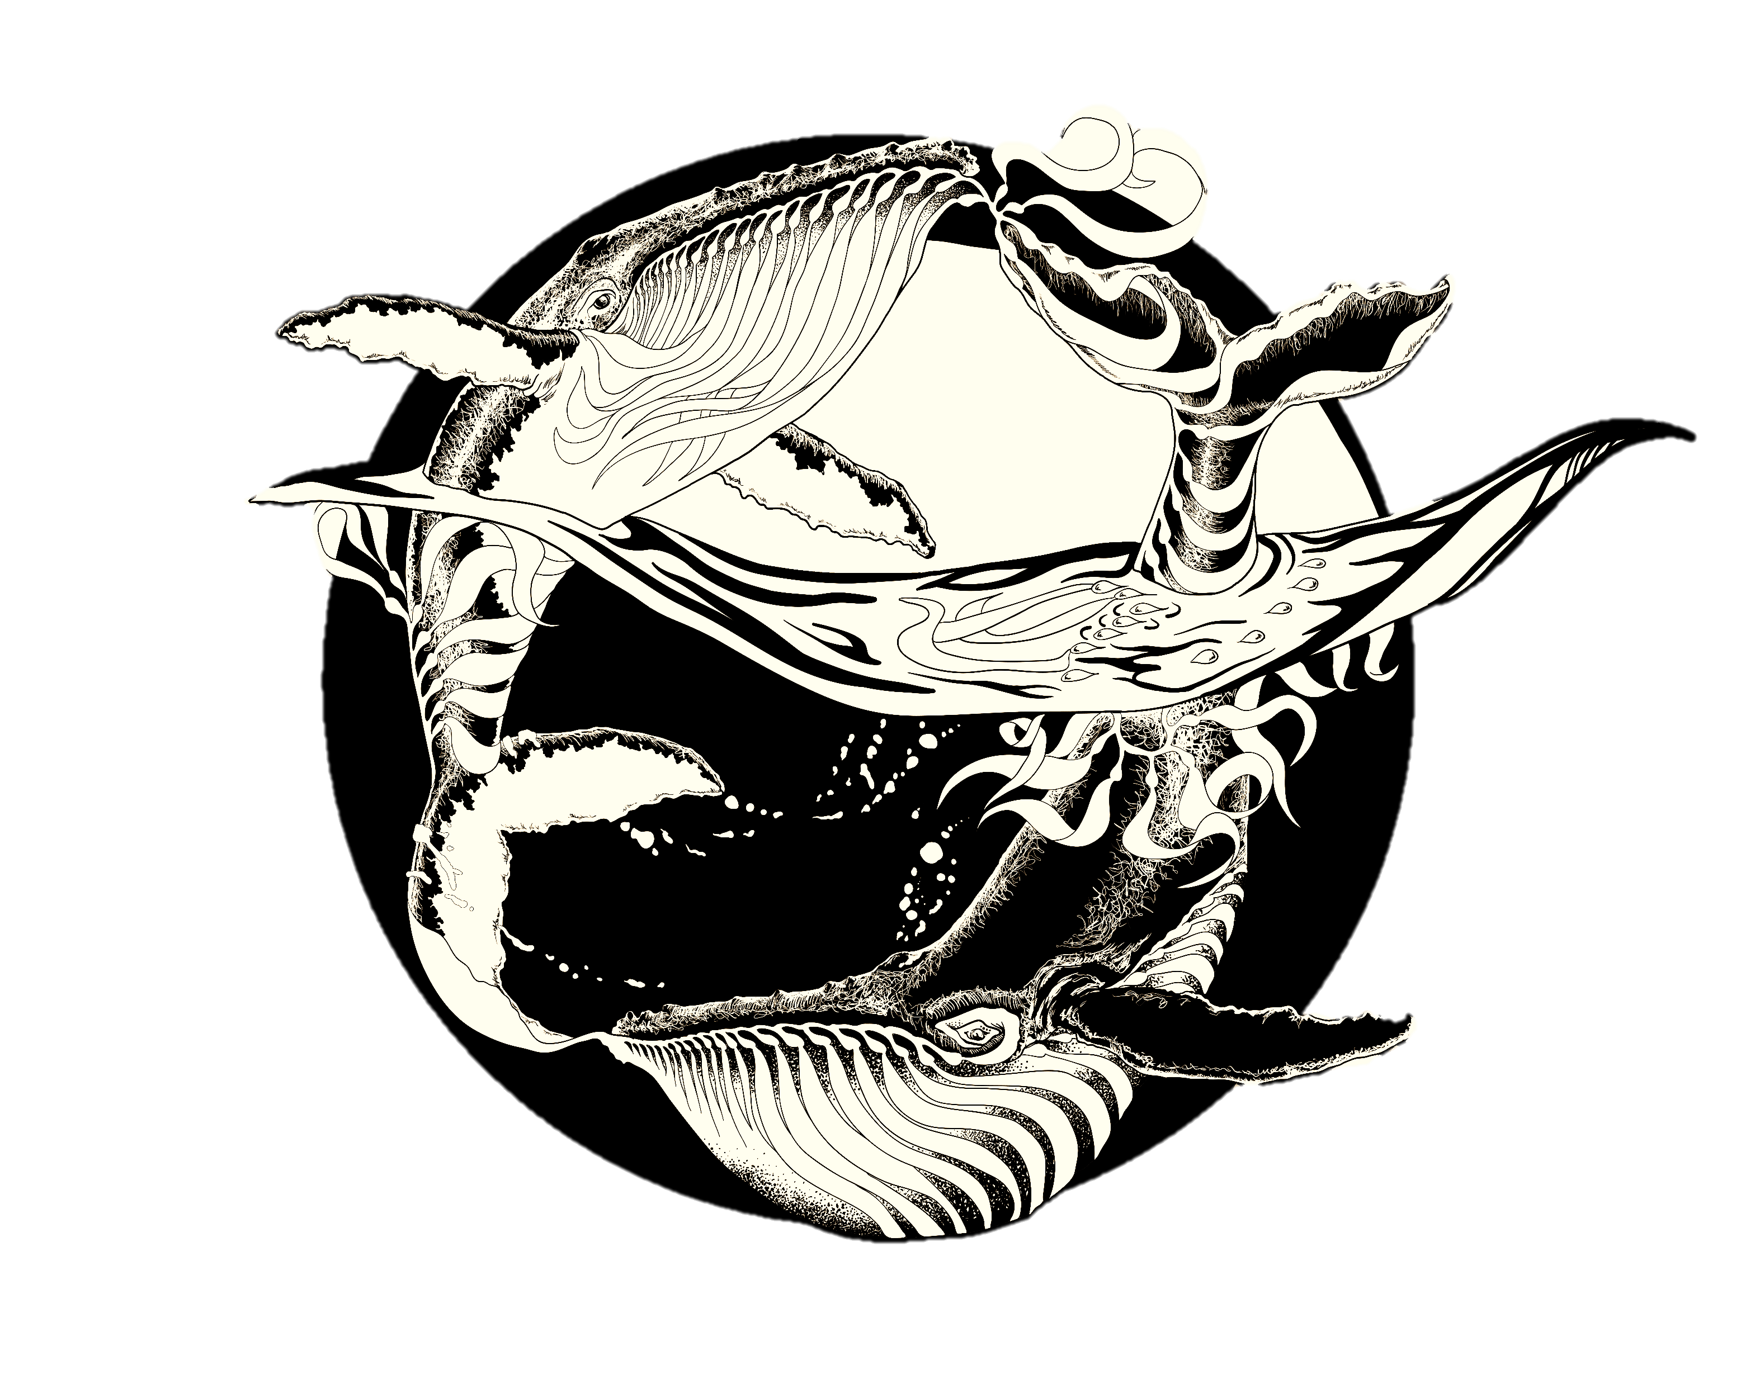
Art for SCIENCE COMMUNICATION
UCSB Workshop 2/18/2020
Jessica Kendall-Bar

Slide 2
TABLE OF CONTENTS
Intro to Digital Art: VECTOR V. RASTER ARTWORK
Bring it into Powerpoint: Advanced Tips and Tricks for Flashy Grad Student Presentations
Intro to Inkscape/Illustrator: Outline your study organism

Slide 3
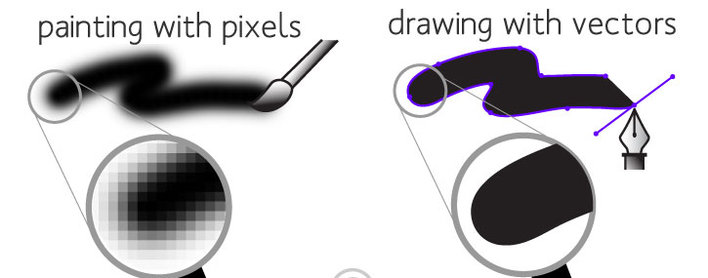
VECTOR v. RASTER ARTWORK
“Rasterizing”
RASTER GRAPHIC
VECTOR GRAPHIC
Composed of pixels.
Draw curves only by pixel approximation.
Enlarging causes loss of resolution.
Can “paint” gradients and smooth blending.
Composed of mathematical paths.
Continuous and smooth lines.
Enlarging does not cause loss of resolution.
Usually have sharp, graphic look with crisp lines.
Programs: Adobe Photoshop (expensive), Procreate ($10, Apple only), GIMP (free)
File types: .jpg, .tif, .png*
“Image Trace”
Programs: Adobe Illustrator (expensive), Inkscape (free)
File types: .svg*, .emf*, .pdf*, .eps
*although these file types can be imported into Powerpoint, it is usually easier to export a .png approximately the right size for your powerpoint and to use that.
.png’s are ideal for Powerpoint because they can be compressed for web and they can have a transparent background

Slide 4
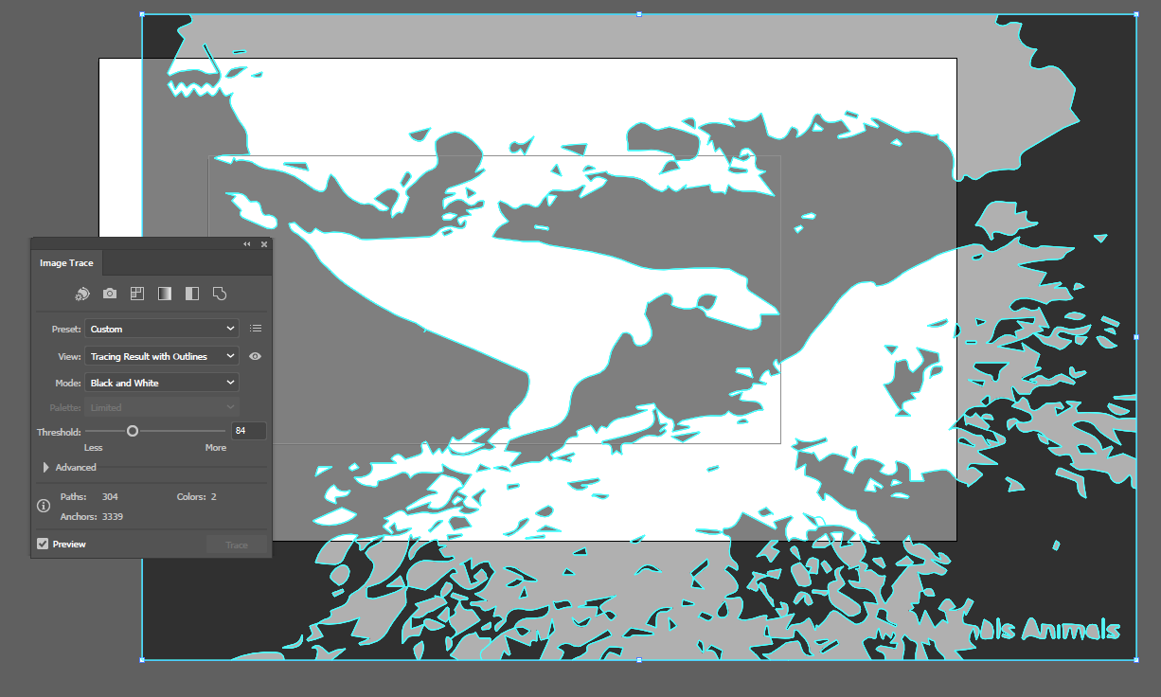
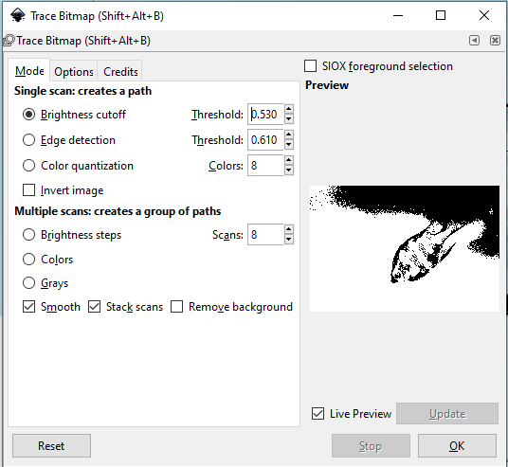
VECTOR v. RASTER ARTWORK
“Rasterizing”
RASTER GRAPHIC
VECTOR GRAPHIC
“Image Trace”
Illustrator: Object> Image Trace
Inkscape: Path> Trace Bitmap

Slide 5
DIGITAL ART
TIPS
SHORTCUTS
ORGANIZATION IS KEY!
Create many versions (save often!) and layers with meaningful filenames.
Setting up your workspace
Open Layers (Illustrator: Window>Layers; Inkscape: Shift+Ctrl+L
Open Fill/Stroke Properties (Illustrator: Window>Stroke, Gradient, Transparency; Inkscape: Shift+Ctrl+F)
Set up your canvas. (Illustrator: Artboard tool; Inkscape: Shift+Ctrl+D).
Use guidelines, align, and distribute! Hold down shift to snap to regular positions.
 | Illustrator | Inkscape | Powerpoint
Paste in place | Ctrl + F | Ctrl + alt + V | default if in new slide or if original object is moved.
Zoom in/out | Ctrl + “+” or “-” | “+” or “-” | Ctrl + scroll up / down
Move canvas | Spacebar + click & drag | Spacebar | Scroll.
Resize with locked proportions | hold Shift while dragging | hold Ctrl while dragging | hold Shift while dragging
Rotate | Hover outside object while selected to see rotation icon | Click once, then twice on object to show rotation handles | Rotate with rotation icon above object when selected
Reflect | Object> Transform> Reflect | H for horizontal reflection or V for vertical reflection | Arrange> Rotate> Flip Horiz/Vertical
Edit points of path/object | Use direct selection (V) tool to select path segments or points | Double click on object to enter “Edit Path by Nodes” where you can select path segments or points | Right click line or path and select “Edit Points”

Slide 6
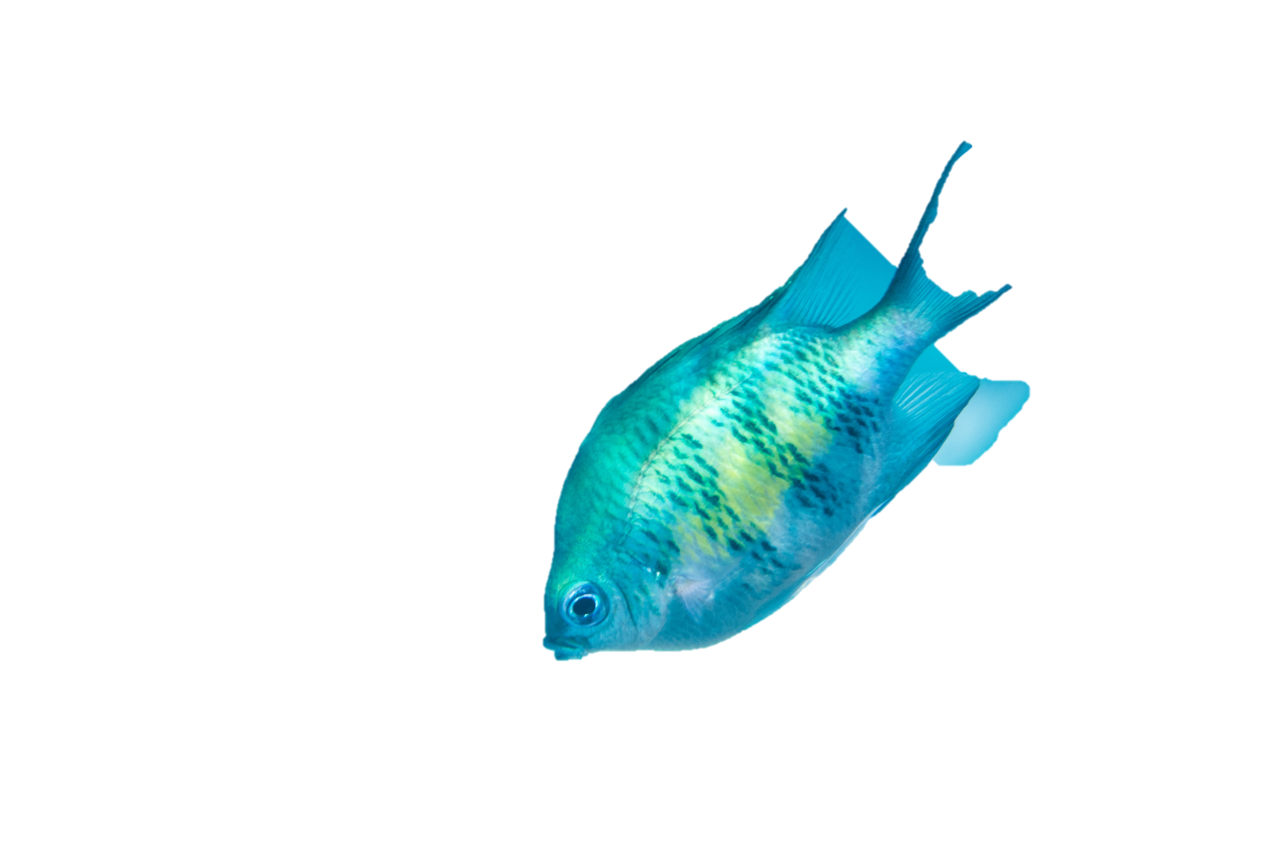
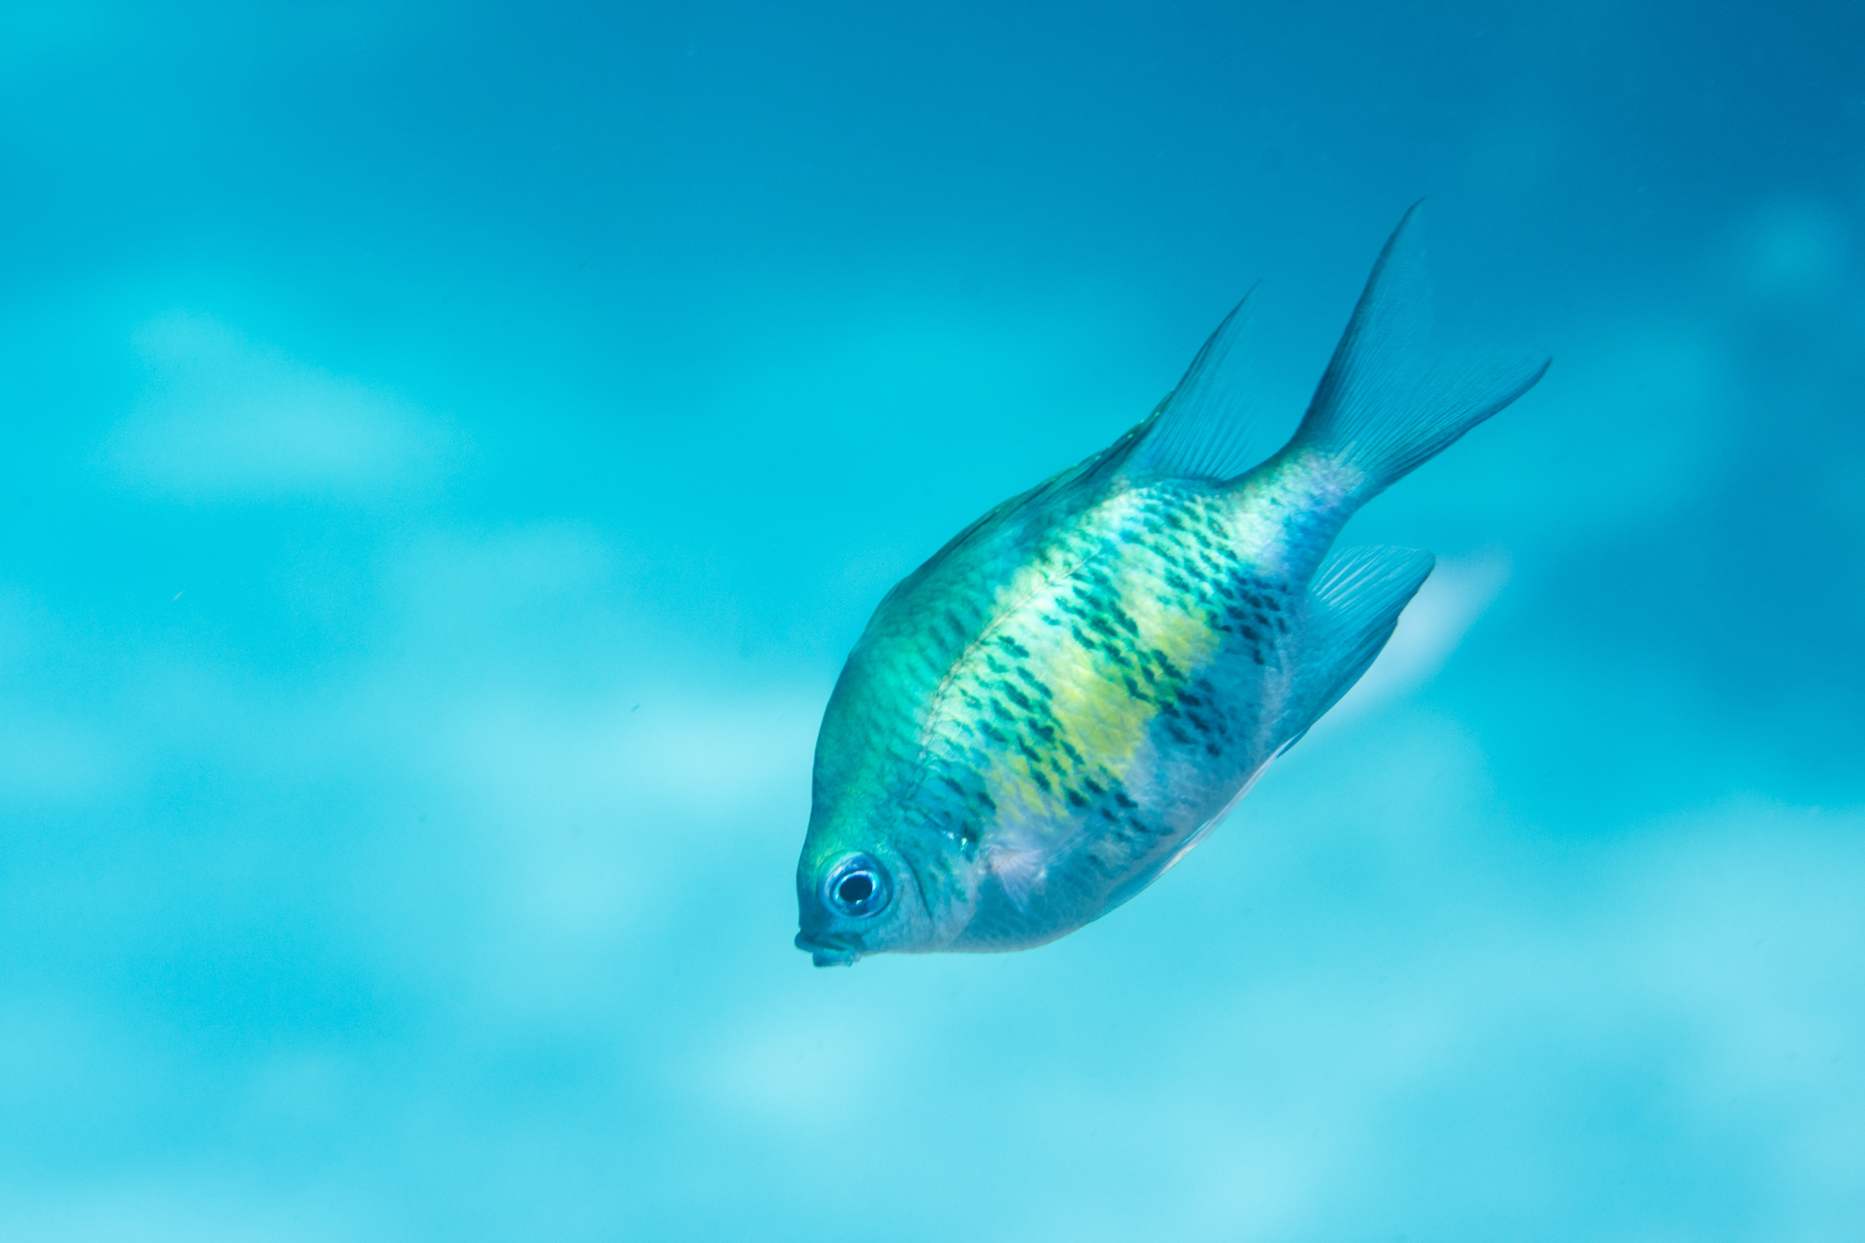
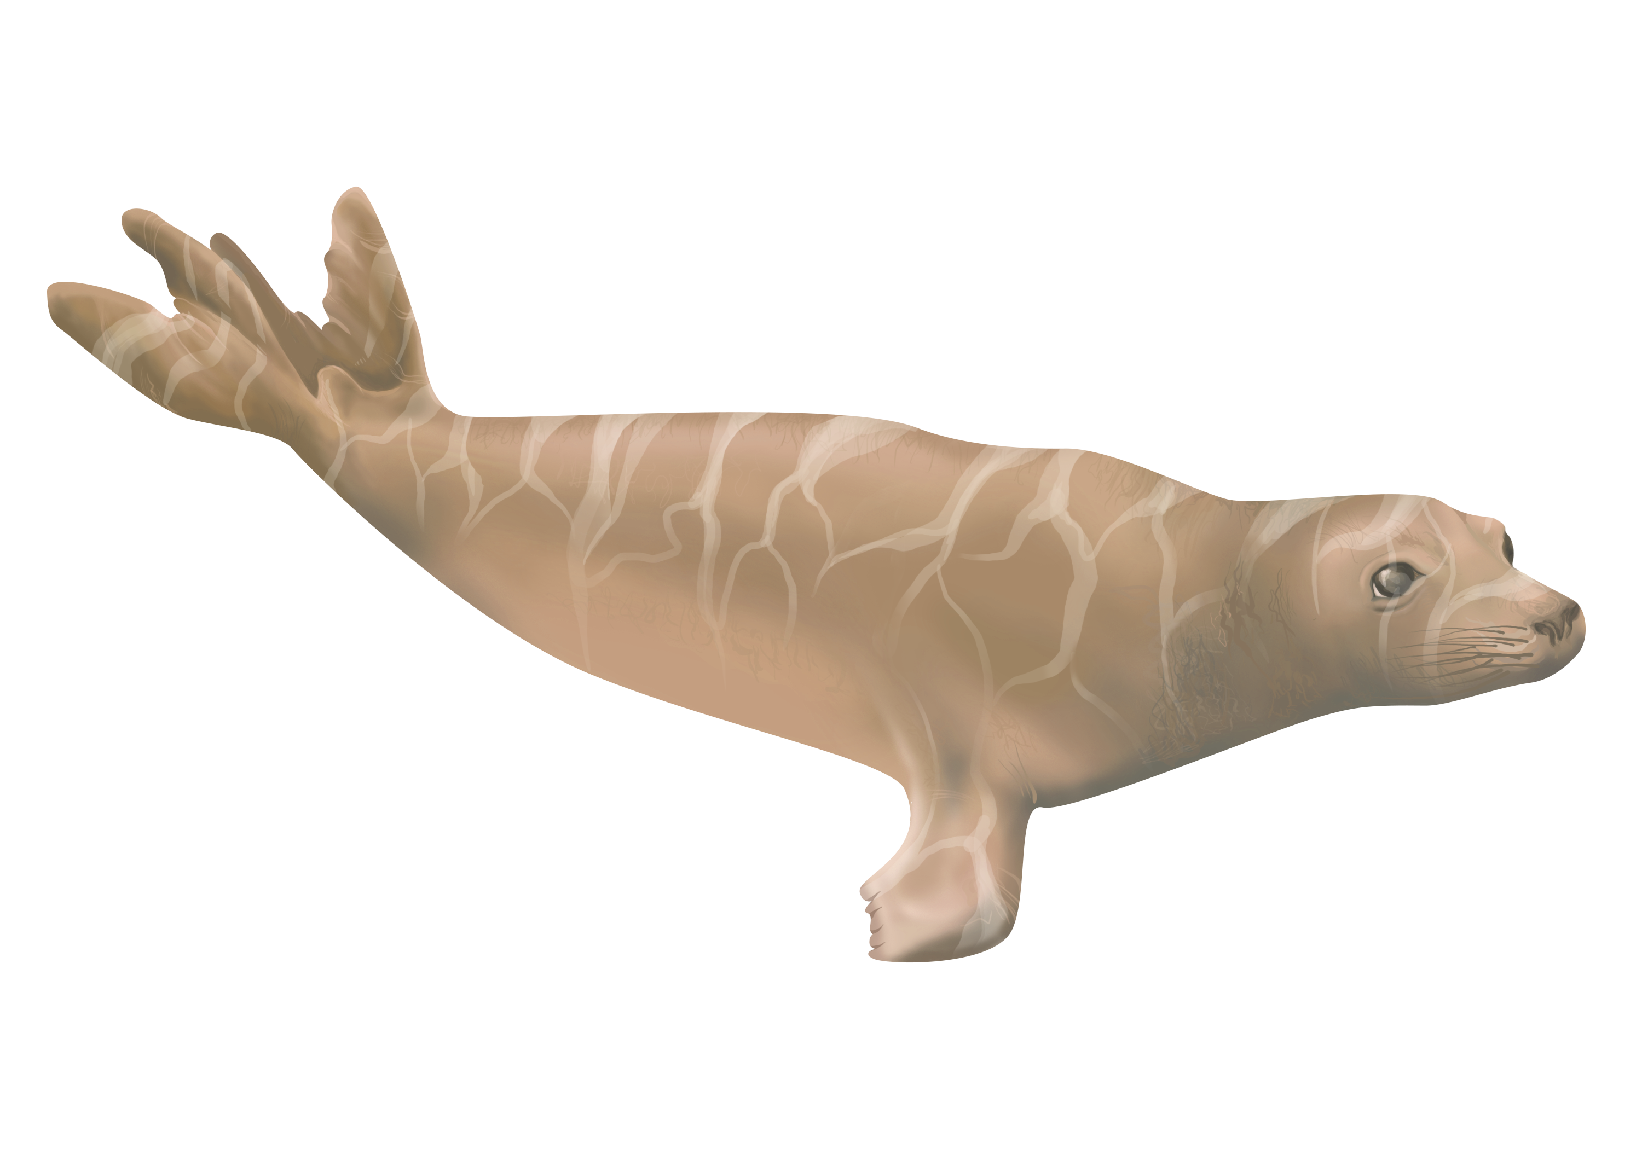
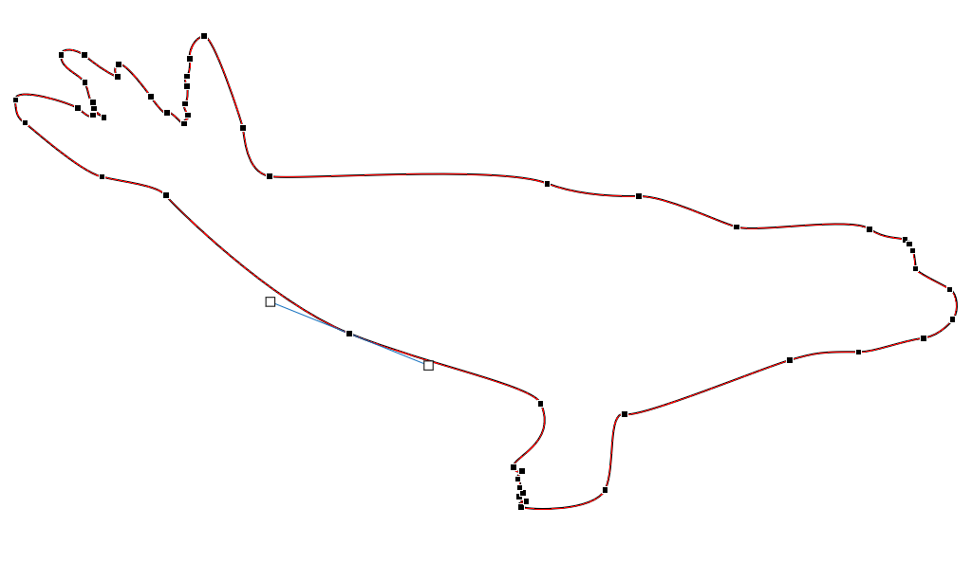
DESIGNING YOUR GRAPHICS
TIPS
Change color of images to match your theme.
Edit curves and lines just like in Illustrator/Inkscape by converting to shape and right clicking>“Edit Points.
Don’t remove the background in Powerpoint, it usually does not turn out very well… use Photoshop or GIMP.
Pay attention to guidelines and ALIGN your graphics as much as possible.

Slide 7
DESIGNING YOUR PRESENTATION
TIPS
TRICKS
Display an outline at the bottom of slides.
Use the selection pane to rename/reorder.
Keep text to a minimum; use graphics!
To keep images looking crisp: use vector graphics or high-resolution raster images.
Practice your talk, transitions, and animations; don’t be surprised by your slides!
Choose 3 fonts you like for Titles, Subheadings, and body text. Choose 3 colors to use.
Navigate to ANY slide by typing in the number of the slide and pressing enter, while presenting.
Right click while presenting to “See All Slides” to let your audience see thumbnails of all slides and click on them to open.
F5 to begin presentation at beginning. Shift+F5 at current slide
Slide Master! Next slide…

Slide 8
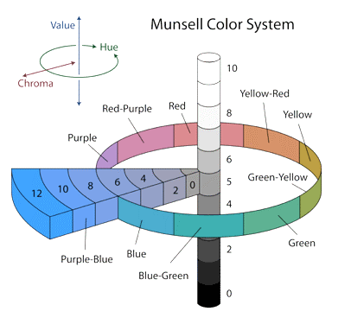
HOW TO TALK ABOUT COLOR
same saturation & hue
VALUE
Darker colors make white text easier to see.
“lightness”
DARK
LIGHT
DARK
same hue & value
SATURATION
Very saturated colors are often hard on the eyes.
“intensity” or chroma
UNSATURATED
SATURATED
same saturation & value
HUE
Stick to ~3 hues to keep things simple.
“color”
RED
PURPLE

Slide 9
COLOR PALETTE EXAMPLE
1
2
3
same saturation & hue
VALUE
“lightness”
same hue & value
SATURATION
“intensity” or chroma
same saturation & value
HUE
“color”

Slide 10
SLIDE MASTER
MAKE YOUR OWN THEME
Go to View>Slide Master…

Slide 11
ANIMATIONS
TIPS AND CAUTIONS
ANIMATIONS I LIKE…
Use Animation Pane to time animations (on click, with/after previous)
Only use animations when they help clarify or emphasize content
Minimize use of slow animations like fade in/out (or speed them up)
Can split animations into separate slides and use “Morph” transition
Wipe left to right for the “reveal” of your data or for “drawing” shapes
Appear for each bullet point of a list to keep your audience’s attention (“By Paragraph” in Effect Options)
Motion paths and spin to show behavior/movement
When adding multiple animations to a single object, press “Add Animation” to add second animation without overwriting existing animation.

Slide 12
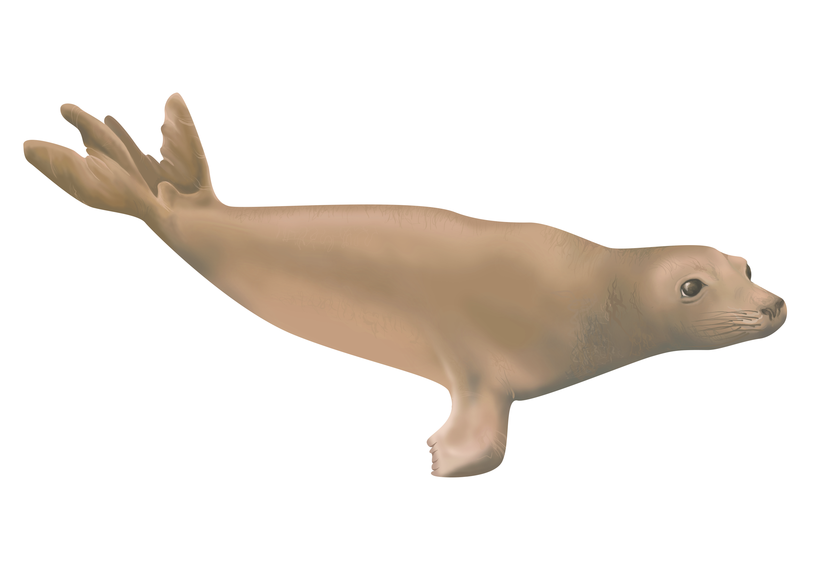
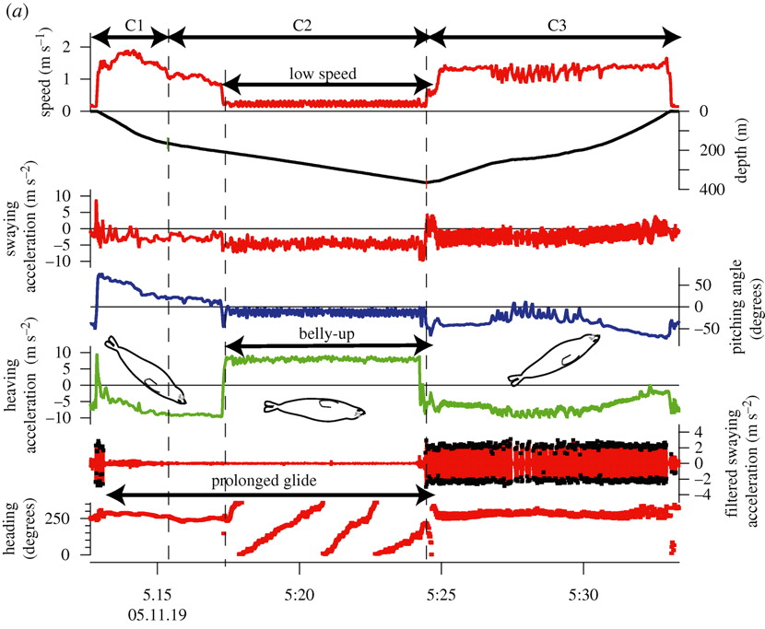
Ch. 3 GOING WILD: PRELIMINARY RESULTS
EXAMPLE ANIMATIONS
SLEEP BEHAVIOR
SWS : 5.2min
Recording in water.
AW
QW
SWS
REM?
A->QW
L EOG
µV
Does this pattern look familiar?
L EMG
R EEG
L EEG
HR ♡
δ SPECTRAL POWER
Hz
4 2 0
BACKGROUND ~ 1: DRIFTING ~ 2: VALIDATION ~ 3: GOING WILD ~ CONCLUSION
Notes:
We can see that it is very similar to the sleep cycle on land. This animation shows the animal’s behavior during its sleep cycle.
First it is actively swimming to the bottom of the pool,
where it remains stationary… eventually closes its eyes..
And the animal falls asleep (You can see its EEG activity picking up into these slow waves that you can also see in the spectrogram in the delta, or slow wave, frequency)
Then, there is a shift when the animal’s EEG goes down to waking levels during what I think could be Rapid Eye Movement or REM sleep,
and then the animal wakes up and swims to the surface and ends its apnea.
Now, does this pattern remind you of anything?
It closely matches the behavior of the drift dives they perform in the wild.

Slide 13
BACKGROUND
THE MORPH TRANSITION
MARINE MAMMAL SLEEP
HUMANS
PHOCIDS (true seals)
OTARIIDS (fur seals & sea lions)
CETACEANS (whales & dolphins)
always
on land
in water
always
BILATERAL SLEEP
UNIHEMISPHERIC SLEEP
WAKING
SLEEPING
WAKING
SLEEPING
LEFT HEMISPHERE
WAKING HEMISPHERE
RIGHT HEMISPHERE
SLEEPING HEMISPHERE
BACKGROUND ~ 1: DRIFTING ~ 2: VALIDATION ~ 3: GOING WILD ~ CONCLUSION
Notes:
Marine mammals are voluntary air breathers who are vulnerable to visual predators when breathing and sleeping at the surface. Marine mammals have evolved two main strategies to allow them to sleep in the challenging ocean environment :
The first is the ability to sleep while holding their breath: Phocids, or true seals, sleep like humans, bilaterally and in both hemispheres of their brain, so they have evolved great breath-holding abilities to allow them to sleep underwater.
Then, Cetaceans like whales and dolphins, can sleep with only half of their brain at a time, called unihemispheric sleep. It is thought that this type of sleep allows them to maintain vigilance as well as motion while they sleep.
Otariids can switch between sleeping like a human on land and sleeping like a cetacean while in water.
These unique sleep patterns were discovered using invasive methods on captive animals. My dissertation focuses on developing a way to non-invasively record sleep in freely moving elephant seals.

Slide 14
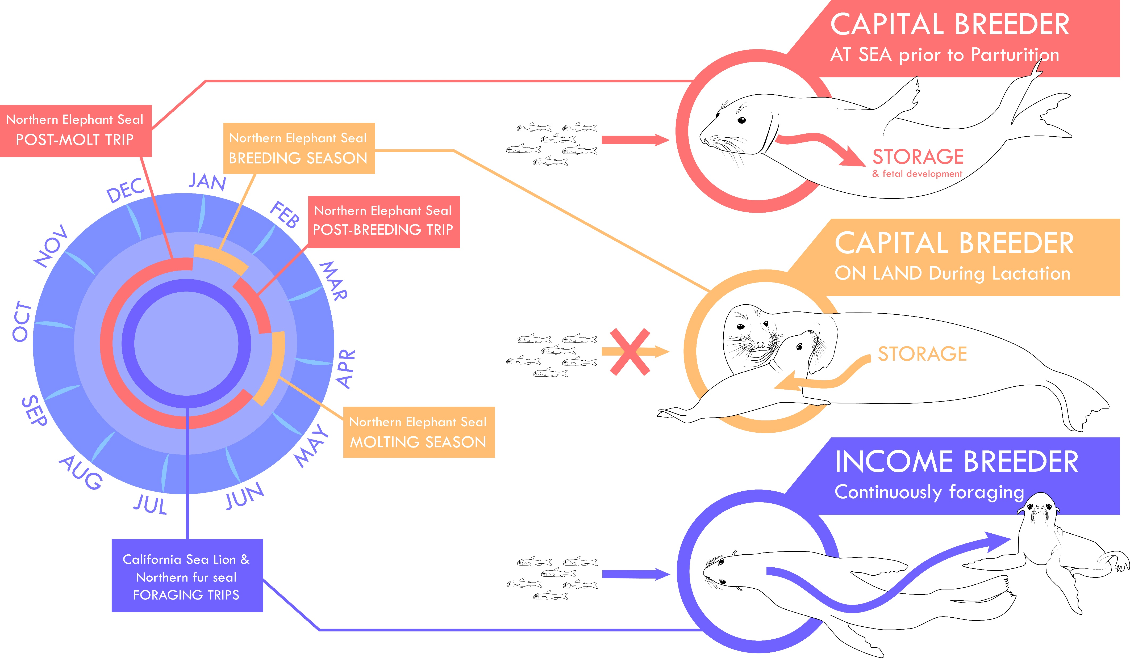
BACKGROUND
THE NORTHERN ELEPHANT SEAL
THE STUDY SYSTEM:
Well-studied species
Well-established tagging protocols
Deep dives
Long migrations
As capital breeders, life history with interesting implications for sleep…
BACKGROUND ~ 1: DRIFTING ~ 2: VALIDATION ~ 3: GOING WILD ~ CONCLUSION
Notes:
My dissertation focuses on northern elephant seals. They are an interesting study system for a number of reasons:

Slide 15
INTRO TO INKSCAPE
OUTLINING YOUR STUDY ORGANISM
Put your reference photo into Inkscape by dragging & dropping or Importing it.

Slide 16
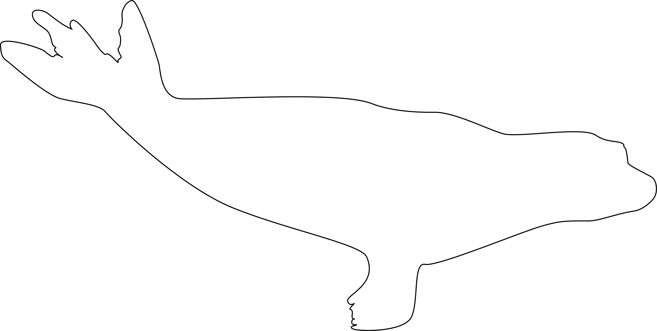
INTRO TO INKSCAPE
OUTLINING YOUR STUDY ORGANISM
Use pen tool / Bezier tool (Shift + F6) to draw your outline like is shown to the right. Create a CLOSED loop outline, starting and ending on the same point.
Have patience.

Slide 17
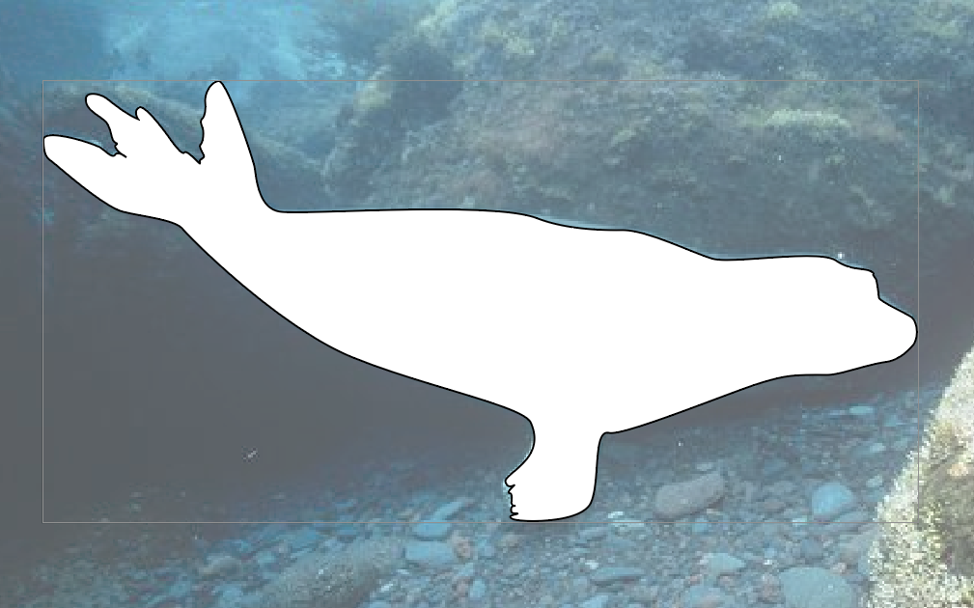
INTRO TO INKSCAPE
OUTLINING YOUR STUDY ORGANISM
Add a white fill to your outline, and a thin black stroke, so that it pops out from your reference photo. You can do this in the Fill/Stroke panels in Illustrator and Inkscape and in “Shape Outline” and “Shape Fill” in Powerpoint.

Slide 18
INTRO TO INKSCAPE
OUTLINING YOUR STUDY ORGANISM
Add lines to make the body outline more meaningful and detailed.
In Inkscape: Select the Pen/Bezier tool and select “Triangle In” to create a triangle stroke effect along your path (a tapered line).
In illustrator, you can create the lines in the pen tool and flexibly change the stroke effect afterwards by changing the “Profile” of your stroke in the Stroke effects panel.

Slide 19
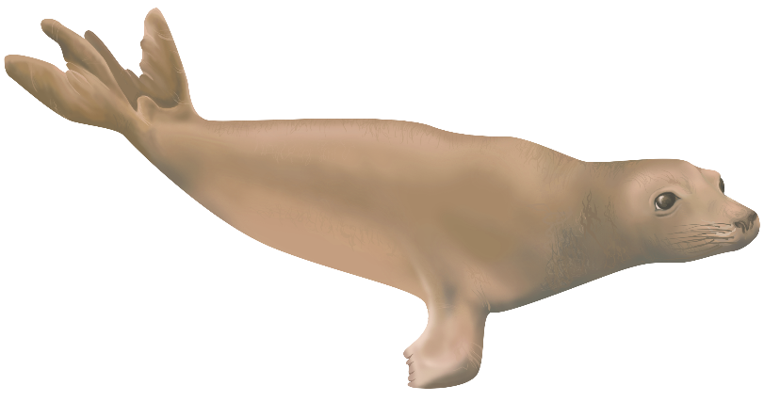
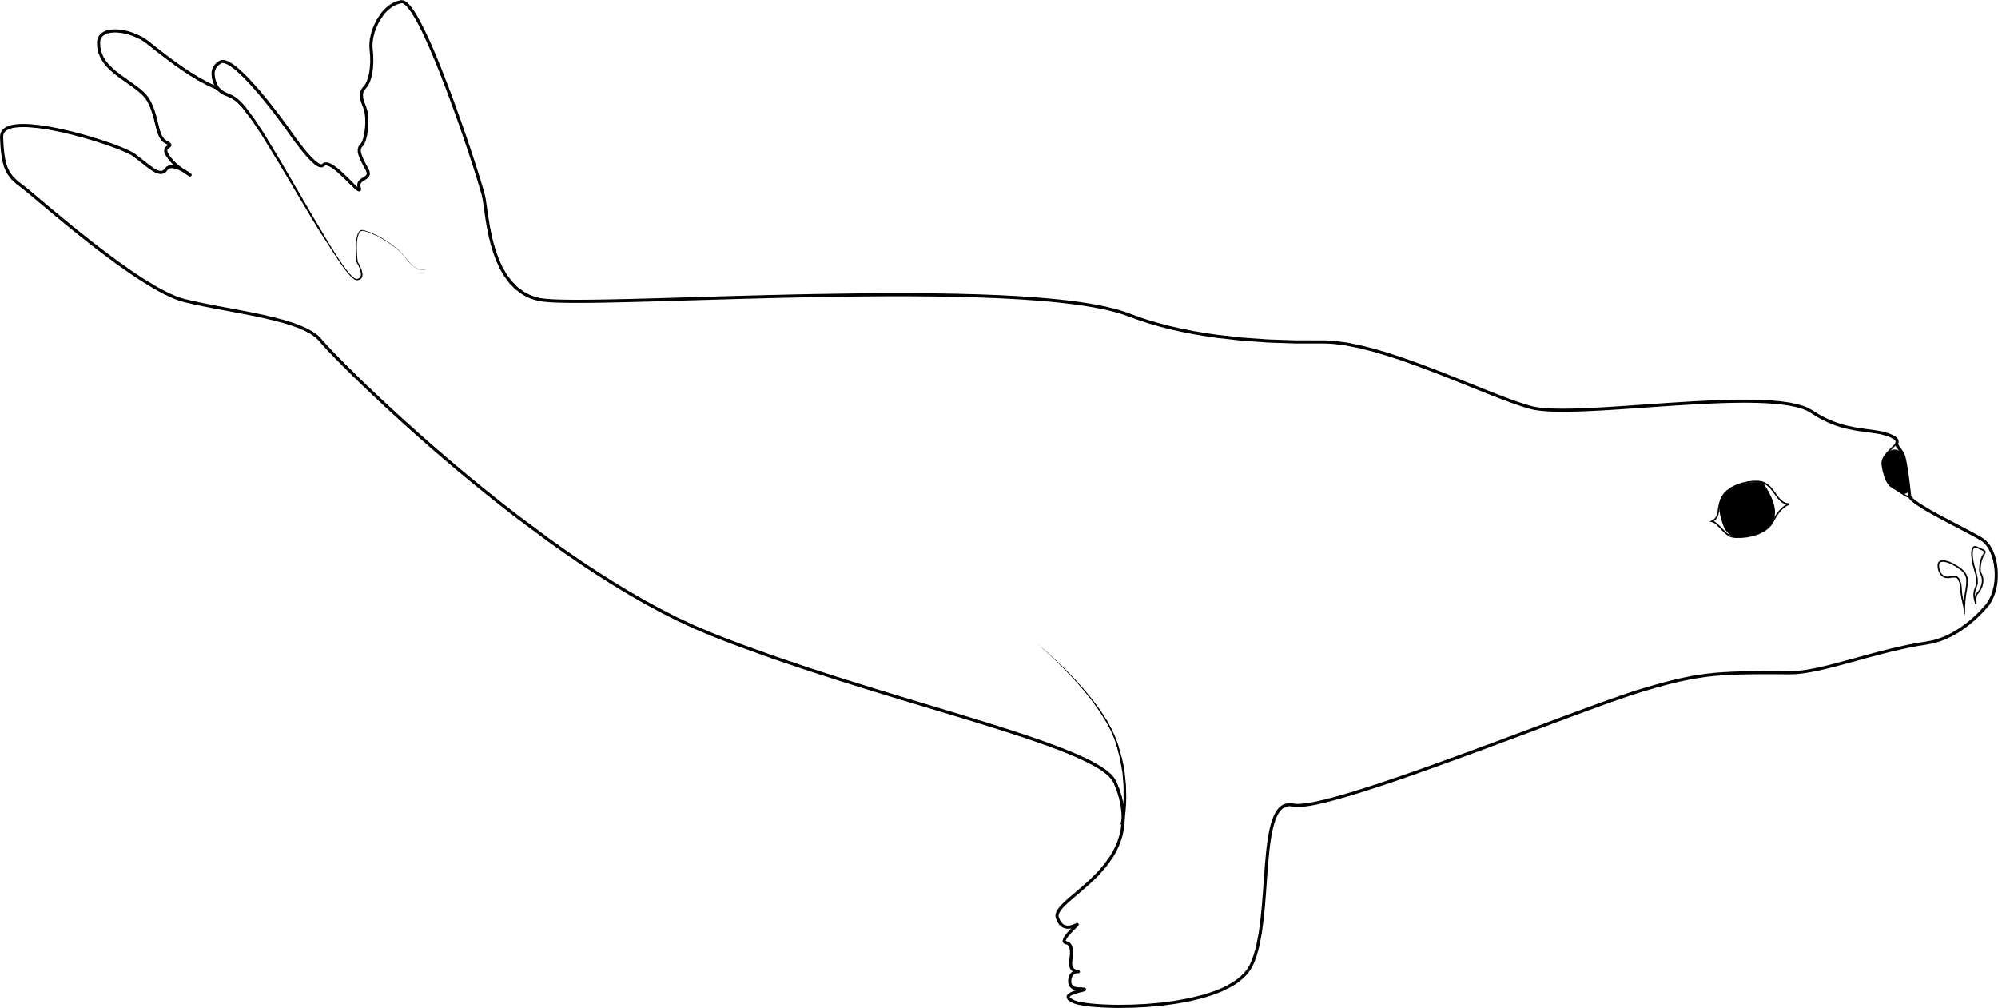
INTRO TO INKSCAPE
OUTLINING YOUR STUDY ORGANISM
Next, add in any other details to your study organism using these same methods. Make sure to start a new layer each time you add something new.
Then, digitally paint it in!
Next workshop will cover how to do this.

